Slide 1
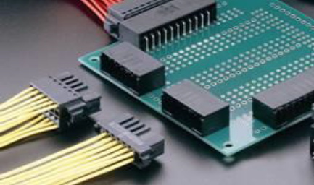
Dynamic–New generation connector
The Dynamic family is a broad new generation of connector products that can be used to transmit small current in signal loops as well as large current in power loops.
Product features:
• The product is designed for signal interface and power loop for
industrial automation
• For wire-to-panel applications
• 2-point contact box terminal, lock design with lock tone notification,
anti-misinsertion key, etc.
• Dual-row, multi-layer design, 2.00mm PIN pitch,
• load current 3A, Voltage up to 250V MAX
• Plating thickness up to 15 U "gold, fully account for performance and
cost
3

Slide 2
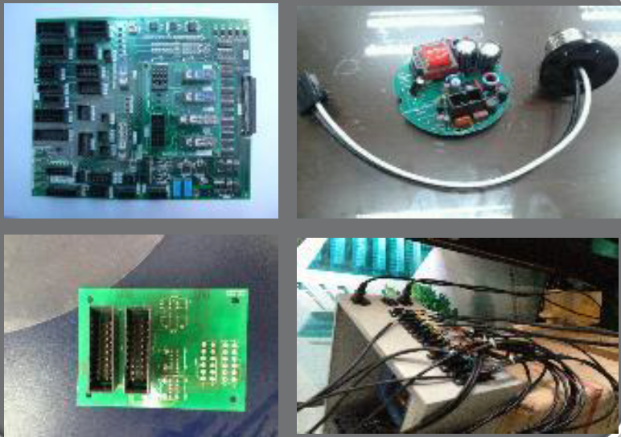
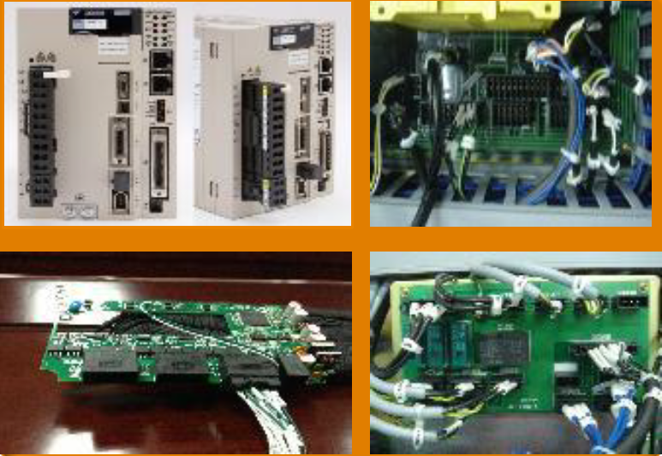
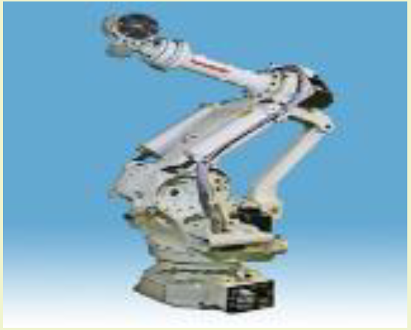
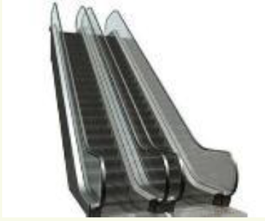
Industry And Application
Industrial automation & Controls：
√ Motion Control
√ Robot Control
√ Frequency converters
√ Electrical automation
√ Machine tools and equipment
√ Uninterruptible Power supply
√ Various power sources
√ Energy management
Commercial building & Railway：
√ Lighting control
√ Elevator and escalator control
√ Revolving door control
√ Subway screen door
√ Railway and subway air
conditioning control
√ Other traffic monitoring
Vibration environment reliable locking structure maintenance-free high density space saving
4

Slide 3
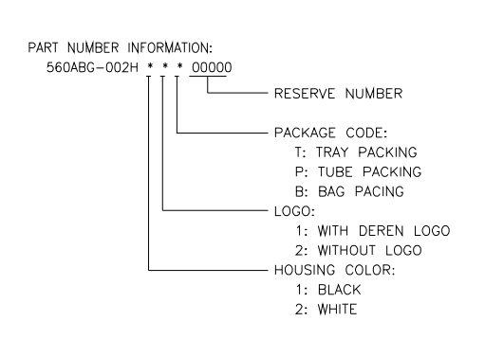
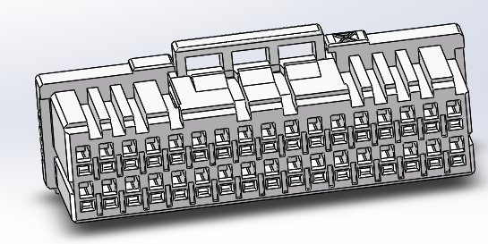
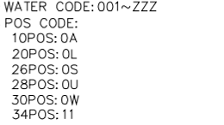
Industrial Connector Product List
WTB Female Part Number Description:
**
***
WTB Female
2

Slide 4
Industrial Connector Product List
Item | P/N | Description | Specification |  |  |  |  | Dimension
 |  |  | Pin Count | Pitch | SMT/ DIP | Center Height | On Board Height | L | W | H
1 | 5617BG-001H****0000 | WTB Famale 40P HSG Black | N/A | 2 | N/A | N/A | N/A | 42.60 | 12.45 | 11.3
2 | 5611BG-003H****0000 | WTB Famale 34P HSG Black | N/A | 2 | N/A | N/A | N/A | 36.60 | 12.45 | 11.3
3 | 560WBG-001H****0000 | WTB Famale 30P HSG Black | N/A | 2 | N/A | N/A | N/A | 32.60 | 12.45 | 11.3
4 | 560UBG-002H****0000 | WTB Famale 28P HSG Black | N/A | 2 | N/A | N/A | N/A | 30.60 | 12.45 | 11.3
5 | 560SBG-002H****0000 | WTB Famale 26P HSG Black | N/A | 2 | N/A | N/A | N/A | 28.60 | 12.45 | 11.3
6 | 560NBG-002H****0000 | WTB Famale 22P HSG Black | N/A | 2 | N/A | N/A | N/A | 24.60 | 12.45 | 11.3
7 | 560LBG-002H****0000 | WTB Famale 20P HSG Black | N/A | 2 | N/A | N/A | N/A | 22.60 | 12.45 | 11.3
8 | 560ABG-002H****0000 | WTB Famale 10P HSG Black | N/A | 2 | N/A | N/A | N/A | 12.60 | 12.45 | 11.3
2

