Slide 1
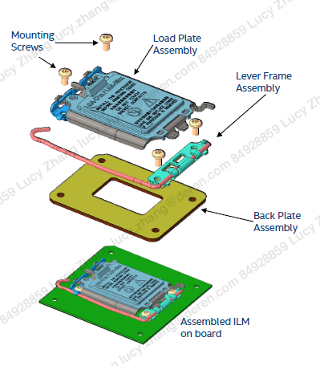
CPU SOCKET ILM PRODUCT FAMILY
LGA 1700 SOCKET ILM-V0
RELEVANT INFORMATION
The Independent Loading Mechanism (ILM) provides the force needed to seat the 1700-LGA land package onto the socket contacts. The ILM is physically separate from the socket body. The assembly of the ILM to the board is expected to occur after all soldering processes are complete. The exact assembly sequence is dependent on manufacturing preference and test flow.
The ILM has two critical functions –deliver the force to seat the processor onto the socket contacts and distribute the resulting compressive load evenly through the socket solder joints.
The ILM consists of three subassemblies. They include the Load Plate Assembly, Lever Frame Assembly, and Back Plate Assembly.
Four (4) standard 6-32 thread screws are used to assemble the ILM. The reference design incorporates a T-20 Torx^ head fastener. The Torx^ head fastener was chosen to ensure end users do not inadvertently remove the ILM assembly and for consistency with previous client socket ILM’s. The Torx^ head fastener is also less susceptible to driver slippage.
Once assembled, the ILM is not required to be removed to install/remove the motherboard from a chassis
All components contacting the PCB have an insulating plastic film adhered to the component to protect against shorts and minimize the impact to signal integrity.

Slide 2
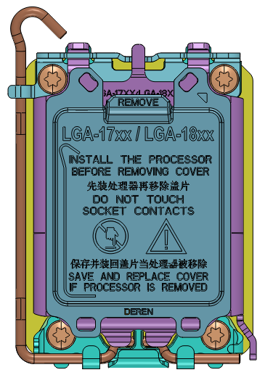
CPU SOCKET ILM PRODUCT FAMILY
LGA 1700 SOCKET ILM-V0
PART NUMBERS & STRUCTRUE
Part Number Description:
RoHS code:
H: Halogen free.
Tail length & Plating code:（LGA 1700）
001.GOLD FLASH_1u”min.Ni:50u”min.
002.Au:15u”min.Ni:50u”min.
003.Au:30u”.Ni:50u”min.
004. ILM
Product series:
01:LGA 115X
05:LGA 1700
Pin number code:
ZZ:≥1088pin.
Connector Homemade Products.
56-ZZ-**-***H
Product Structure
ILM Assembly

